Slide 1
Detecting Phishing Emails with Machine Learning

Slide 2
Table of Contents
Abstract
Introduction
Problem Statement
Data Overview
Methodology
Training and Evaluation Metrics
Result & Analysis
Conclusion

Slide 3

Abstract
Phishing attacks pose substantial risks, compromising sensitive information and leading to significant financial losses.
The project utilized a robust dataset of 50,000 email samples for accurate model training and evaluation.
Three machine learning models compared: Random Forest, SVM, and Neural Networks to optimize phishing detection.

Slide 4
Introduction
Phishing Email Deception: Phishing emails exploit social engineering tactics, tricking users into revealing sensitive data through legitimacy deception.
Limitations of Traditional Detection: Classic detection systems often rely on heuristics, failing to adapt to evolving phishing techniques and tactics.
Need for Data-Driven Solutions: Advanced machine learning approaches are essential for enhancing detection accuracy and adapting to emerging threats.

Slide 5
Problem Statement
Automated classification of phishing emails faces challenges in accuracy, precision, recall, and false positive rates.
Aim to achieve 95% accuracy while minimizing false positives to ensure user trust and security.
High precision and recall are essential for identifying phishing threats without compromising safe email delivery.

Slide 6
Data Overview
The dataset used for this project contains 18,650 labeled email samples. Each entry in the dataset includes the raw email text and a corresponding classification label (Safe Email or Phishing Email). Initial exploration revealed an imbalance in the dataset composition with 11,322 safe emails (60.7%) and 7,328 phishing emails (39.3%). It includes:
Email Text: Raw, unstructured text of the email body, ranging from short solicitations to detailed correspondence.
Email Type: Binary labels (”Safe Email” or ”Phishing Email”).
Unnamed: 0: An index column, excluded from analysis.
The dataset’s recency ensures alignment with contemporary phishing techniques, such as URL obfuscation and urgency driven language.

Slide 7
Dataset Analysis
Class Distribution Analysis
Initial analysis shows class distribution with 60% phishing and 40% safe emails
1
Missing Values Assessment
No significant missing values detected
2
Text Variability Insights Exploratory analysis reveals diverse email text characteristics
3

Slide 8
Data Preprocessing
Label Encoding
Categorical labels were numerically encoded to convert textual classifications into machine-readable numerical values.
1
Text Cleaning
Email text was cleaned by removing punctuation, special characters, and stop words to ensure analytical clarity.
2
TF-IDF Vectorization
Text was transformed using TF-IDF, quantifying word importance while reducing dimensionality for model training.
3

Slide 9
Proposed Models
Logistic Regression: Chosen for its interpretability and effectiveness in binary classification tasks, providing probability estimates.
Random Forest: Robustness to overfitting and capability to handle feature interactions make it suitable for complex datasets.
Neural Network: Selected for its ability to model non-linear relationships, enhancing its effectiveness in detecting complex phishing patterns.

Slide 10
Modeling Overview
Train/Test Split: Data was divided into 80% training and 20% testing sets to validate model performance effectively.
Model Parameter Settings: Logistic Regression uses L2 regularization, Random Forest utilizes 100 trees, Neural Networks include 3 hidden layers.
Theoretical Background: Logistic Regression relies on log-odds; Random Forest builds ensemble trees; Neural Networks emulate biological brain functions.

Slide 11
Training and Evaluation Metrics
Model Evaluation Metrics: Precision, recall, accuracy, and F1-score are critical for assessing phishing detection model performance.
Performance Results Table: Comparison table for all models displays accuracy, precision, recall, and F1-score values succinctly.
Importance of F1-Score: F1-score provides a balance between precision and recall, critical in phishing detection evaluations.

Slide 12
Results Overview
Random Forest Model Performance: Achieved accuracy of 0.9614, showing exceptional capability in classifying emails accurately and efficiently.
Key Metrics Overview: Precision at 0.9377 and recall at 0.9659, emphasizing strong identification of phishing emails with minimal errors.
F1-Score Significance: F1-score of 0.9516 highlights balance between precision and recall, indicating overall model efficacy in phishing detection.

Slide 13
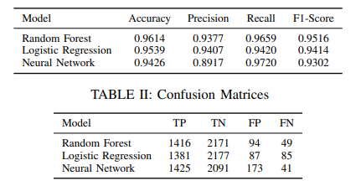
Model Performance Metrics

Slide 14
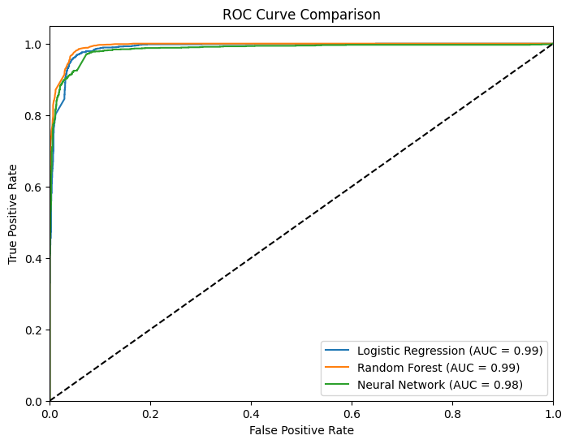
Visualizations and Insights
ROC Curves Analysis: ROC curves illustrate the trade-off between true positive rates and false positive rates across model thresholds.

Slide 15
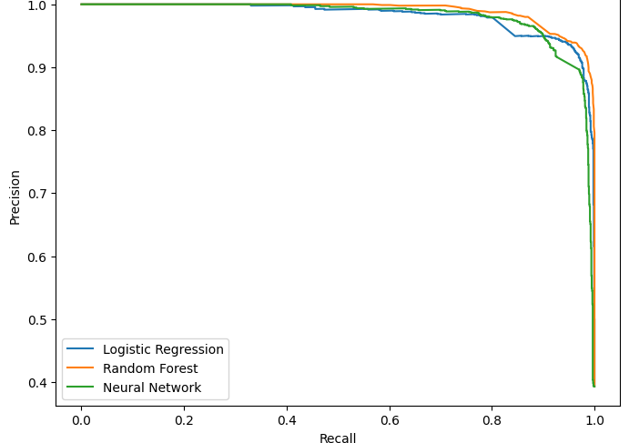
Visualizations and Insights
Precision-Recall Insights: Precision-recall curves provide deeper insights into model performance, focusing on positive class identification effectiveness.

Slide 16
Discussion of Findings
Feature Importance Analysis: Random Forest indicates precipitation as most significant, aiding phishing detection through critical feature evaluation.
Model Performance Comparison: Random Forest demonstrates superior accuracy over Logistic Regression and Neural Networks, enhancing email classification reliability.
Considerations for Alternatives: Logistic Regression offers interpretability, Neural Networks model complexities, requiring careful selection based on use case.

Slide 17
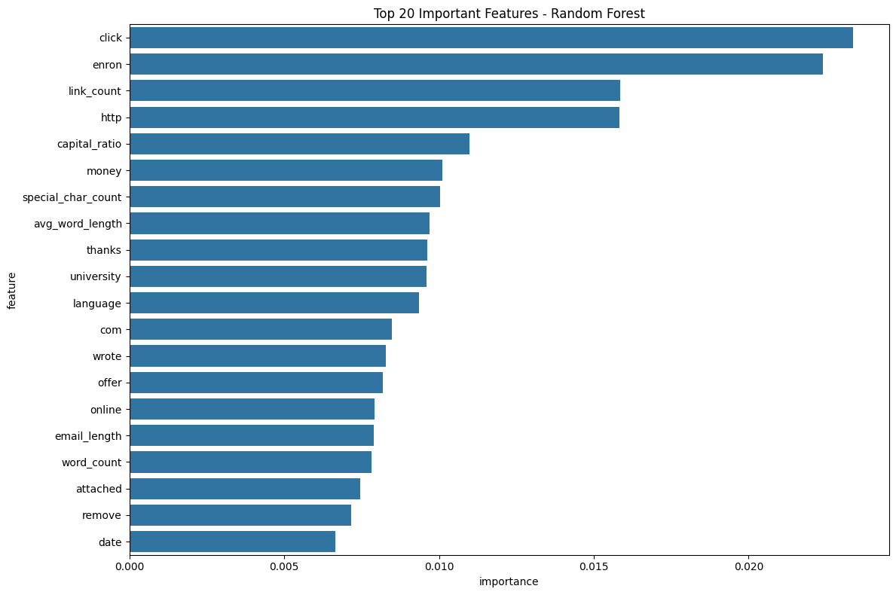
Discussion of Findings
Feature Importance Analysis: Random Forest indicates precipitation as most significant, aiding phishing detection through critical feature evaluation.

Slide 18
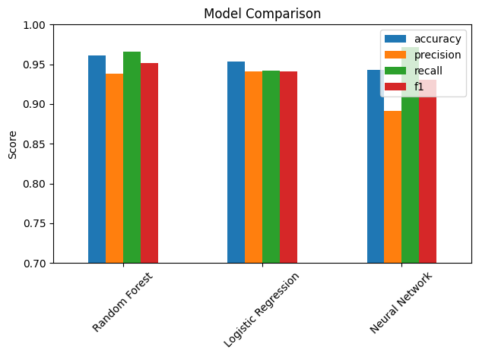
Discussion of Findings
Model Performance Comparison: Random Forest demonstrates superior accuracy over Logistic Regression and Neural Networks, enhancing email classification reliability.

Slide 19
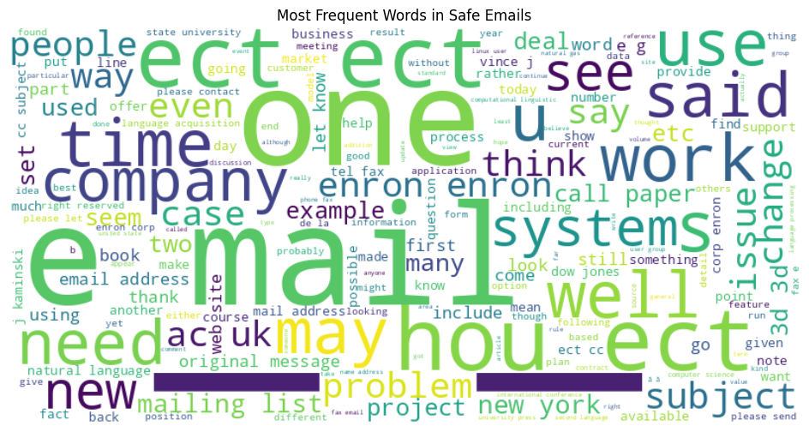
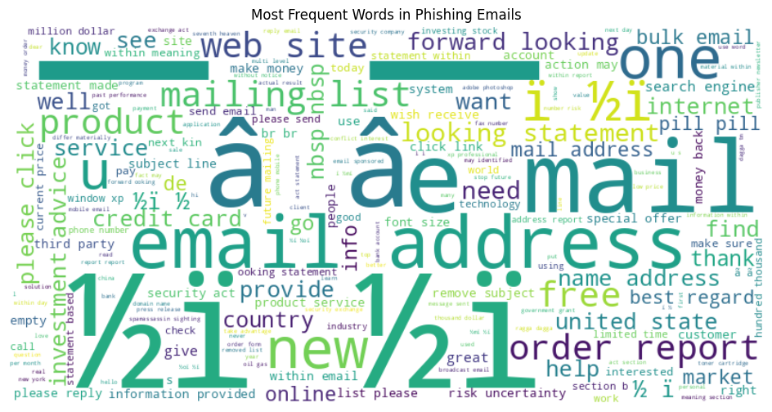
Word Cloud

Slide 20
Conclusion
Random Forest model achieved 96.14% accuracy, showcasing its robustness in identifying phishing emails accurately.
Linguistic analysis reveals distinct patterns in phishing emails, aiding in automated detection system optimization.
Achieved precision of 93.77% and recall of 96.59%, indicating a reliable phishing detection capability.

Slide 21
References
[1] K. Thakur, M. Qiu, K. Gai, and M. L. Ali, "An investigation on cyber security threats and security models," in Proc. 2015 IEEE 2nd Int. Conf. Cyber Security and Cloud Computing, 2015, pp. 307–311.
[2] K. L. Chiew, K. S. C. Yong, and C. L. Tan, "A survey of phishing attacks: Their types, vectors and technical approaches," Expert Syst. Appl., vol. 106, pp. 1–20, 2018.
[3] R. Kumar, G. Poonkuzhali, and P. Sudhakar, "Comparative study on email spam classifier using data mining techniques," in Proc. Int. MultiConference of Engineers and Computer Scientists, vol. 1, pp. 14–16, 2012.
[4] B. Alfayyadh, J. Ponting, M. Alzomai, and A. Jøsang, "Vulnerabilities in personal firewalls caused by poor security usability," in Proc. 2010 IEEE Int. Conf. Information Theory and Information Security, 2010, pp. 682–688.
[5] R. Alabdan, "Phishing attacks survey: Types, vectors, and technical approaches," Future Internet, vol. 12, no. 10, p. 168, 2020.
[6] B. B. Gupta, A. Tewari, A. K. Jain, and D. P. Agrawal, "Fighting against phishing attacks: state of the art and future challenges," Neural Comput. Appl., vol. 28, pp. 3629–3654, 2017.
[7] S. Garera, N. Provos, M. Chew, and A. D. Rubin, "A framework for detection and measurement of phishing attacks," in Proc. 2007 ACM Workshop on Recurring Malcode, 2007, pp. 1–8.
[8] M. Wu, R. C. Miller, and S. L. Garfinkel, "Do security toolbars actually prevent phishing attacks?," in Proc. SIGCHI Conf. Human Factors in Computing Systems, 2006, pp. 601–610.

Slide 22
Thank You

